Slide 1
Team Electrical and
Computer Engineers
intro.cpp
CS_225 final_project.ppt
[California Road System]
<Final Project Presentation>
}
Akhil Nallacheruvu, Ahmed Nahas, Kevin Kim, Peter Yun

Slide 2
Table Of ‘Contents’ {
01
02
03
contents.cpp
CS_225 final_project.ppt
Problem statement
Goals
Dataset Acquisition and Processing
Dataset Acquisition and Processing
Data Storage
Data Format
Data Correction
Algorithms Explored
Dijkstra’s Algorithm
Breadth First Search
Visualization and Results
}
CS225 Final Project Presentation

Slide 3
01 {
[Problem Statement]
problem_statement.cpp
CS_225 final_project.ppt
< Given an undirected dataset of a specific area’s road network and assuming ideal conditions (no traffic, obstacles, limitations, and uniform speed all throughout), what would be the best algorithm (from among breadth-first search and Dijkstra’s algorithm) to deduce the fastest route between two points (road intersection) on a map? >
}
CS225 Final Project Presentation

Slide 4
Goal #1: {
goals.cpp
CS_225 final_project.ppt
< Compare which algorithm - BFS and Dijkstra’s Algorithm - provides efficient and results shorter runtime >
}
Goal #2: {
< Output the paths from each of the two algorithms onto the California Road System dataset>
}
Programming Language

Slide 5
02 {
[Dataset Acquisition
& Processing]
dataset.cpp
CS_225 final_project.ppt
Data Storage
Data Format
Data Correction
}
CS225 Final Project Presentation

Slide 6
data_format.cpp
CS_225 final_project.ppt
Data Format
Source: Real Datasets for Spatial Databases: Road Networks and Points of Interest
https://www.cs.utah.edu/~lifeifei/SpatialDataset.html
Nodes represent road intersections or endpoints
Each node is assigned a unique ID as well as the corresponding longitude and latitude coordinates
Edges consist of unique edge IDs, the starting and ending node IDs for each edge, as well as the distance between these two nodes
The input format of the dataset is in .txt. The dataset includes 21,048 nodes and 21,693 edges

Slide 7
data_format.cpp
CS_225 final_project.ppt
Data Format
California Road Network's Nodes
(Node ID, Longitude, Latitude)
California Road Network's Edges
(Edge ID, Start Node ID, End Node ID, L2 Distance)

Slide 8
data_storage.cpp
CS_225 final_project.ppt
Data Storage
Dataset will be stored in the graph
Each node/intersection of road has:
Number of edges connected to that node
Each edge has weights assigned to it in the implementation of Dijkstra’s algorithm
All the nodes will be stored in vectors which will be called in the relevant functions

Slide 9
data_correction.cpp
CS_225 final_project.ppt
Data Storage
made sure each row has two non-empty columns
each of the two columns have the correct data type (integers)
This step avoided compilation errors due to empty or missing data points

Slide 10
03 {
[Algorithms Explored]
problem_statement.cpp
CS_225 final_project.ppt
Breadth First Search
Dijkstra’s Algorithm
Visualisations and Results
}
CS225 Final Project Presentation

Slide 11
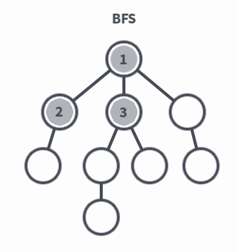
Breadth First Search {
BFS.cpp
CS_225 final_project.ppt
Breadth-First Search
Search “wide” before search “deep” in a graph.
Thus, BFS can be used to find a shortest path from an arbitrary node to a target node.
}
CS225 Final Project Presentation

Slide 12
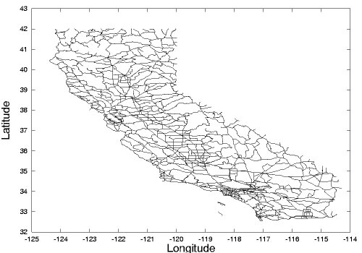

Slide 13
Graph::addEdgeBFS(filename) {
BFS.cpp
CS_225 final_project.ppt
Breadth-First Search
Traverses through provided dataset
Implements adjacency list
adjBFS[node1].push_back[node2]
adjBFS[node2].push_back[node1]
}
CS225 Final Project Presentation

Slide 14
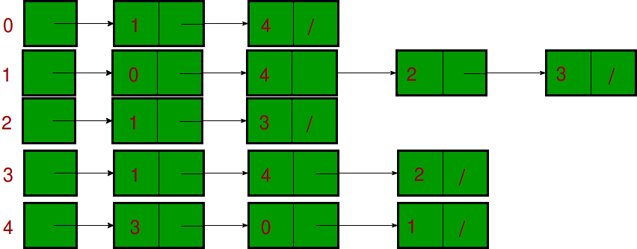
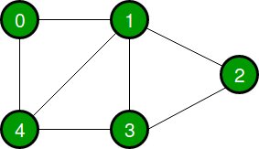
Graph::addEdgeBFS(filename) {
BFS.cpp
CS_225 final_project.ppt
Breadth-First Search
=>
}
CS225 Final Project Presentation

Slide 15
Graph::BFS(start, target, V) {
BFS.cpp
CS_225 final_project.ppt
Breadth-First Search
Implements BFS traversal through our adjacency list
Stops once target is reached
Calculates the total number of nodes traversed (distance)
Saves shortest path traversed
Outputs path into a csv file
}
CS225 Final Project Presentation

Slide 16
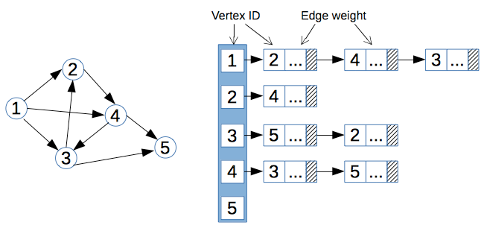
Dijkstra’s Algorithm {
dijkstra.cpp
CS_225 final_project.ppt
}
CS225 Final Project Presentation
Notes:
In order to achieve that goal, we decided to implement dijkstra’s algorithm. So this simple picture explains well the dijkstra’s algorithm. There are unique vertex IDs, and essentially each vertex ID stores other vertex or nodes it is connecting to and weights. We stored the information in the form of adjacency matrix.

Slide 17
Graph::addEdgeDijkstra(filename, V) {
dijkstra.cpp
CS_225 final_project.ppt
Breadth-First Search
Traverses through provided dataset
Implements adjacency list with pairs (nodei, weighti)
adjDIJ[node1].push_back[make_pair(node2, weight)]
adjDIJ[node2].push_back[make_pair(node1, weight)]
}
CS225 Final Project Presentation

Slide 18
Graph::Dijkstra(start, target, V) {
dijkstra.cpp
CS_225 final_project.ppt
Breadth-First Search
Convert distances to weights
Initialize all vertex to infinity.
Create a priority queue.
Add a source.
Get a minimum distance vertex.
Visit neighbors and update the distance.
}
CS225 Final Project Presentation

Slide 19
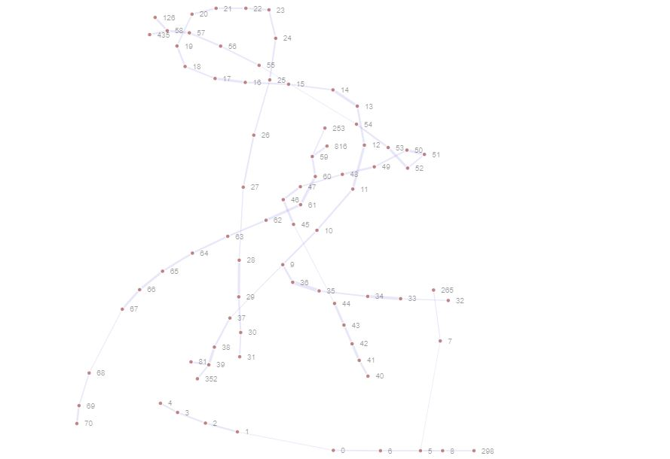
Force Directed Graph {
visualization.cpp
CS_225 final_project.ppt
}
CS225 Final Project Presentation

Slide 20
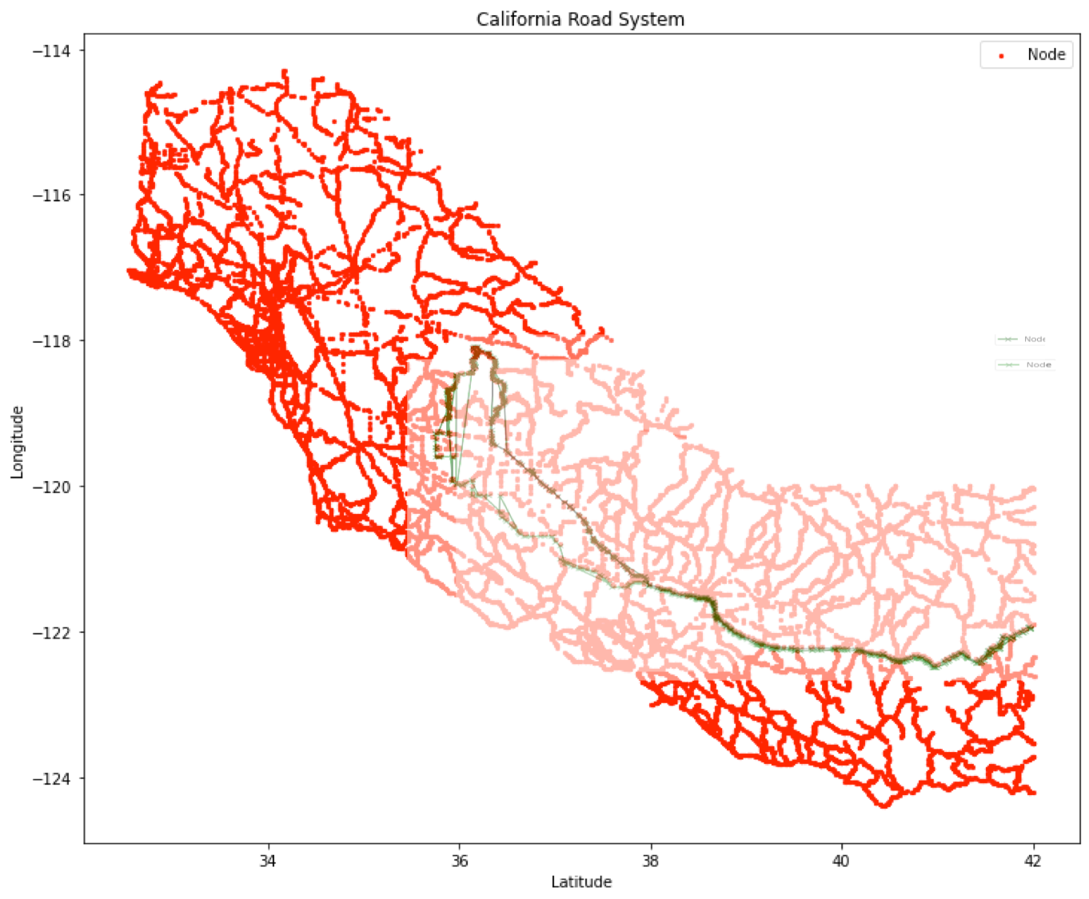
BFS & Dijkstra ‘paths’ {
visualization.cpp
CS_225 final_project.ppt
}
CS225 Final Project Presentation

Slide 21
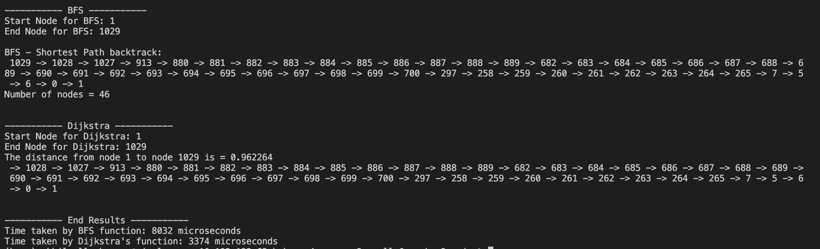
So which algorithm is ‘the winner?’ {
runtime_comparison.cpp
CS_225 final_project.ppt
Winner:
Dijkstra’s Algorithm
}
CS225 Final Project Presentation

Slide 22
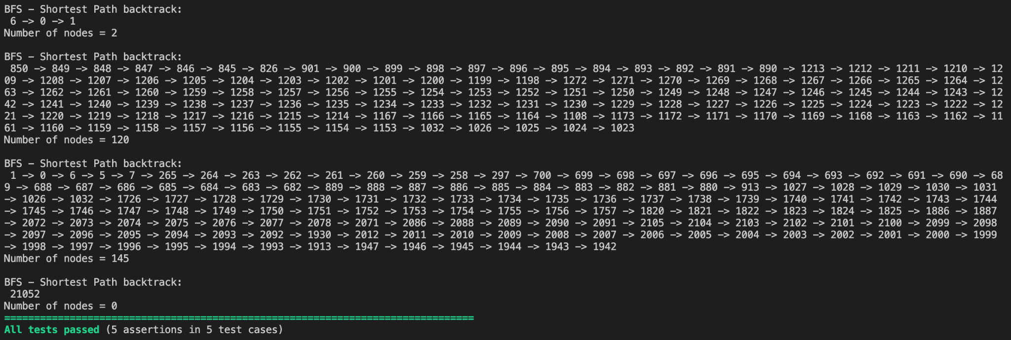
Result {
result.cpp
CS_225 final_project.ppt
}
CS225 Final Project Presentation

Slide 23
Runtimes {
result.cpp
CS_225 final_project.ppt
Space Complexity
Adjacency List: O(n+m)
Breadth First Search
Function eﬃciency: Targets on O(V + E)
V = vertices(nodes) on graph, E = edges on graph
Dijkstra’s Algorithm
Function eﬃciency: Targets on O(V^2)
V = vertices(nodes) on graph
Force directed graph drawing
Function eﬃciency: Targets on O(n^3)
n = number of nodes on graph
}
CS225 Final Project Presentation

Slide 24
-m “Final Project DONE”
git push origin master

